Slide 1
Linux Overview
Jonathan Liu

Slide 2
Table of Contents
Forensics Questions
User Settings
System Configuration
Updates
Firewall
Finding and Removing Suspicious Files/Applications

Slide 3
Terminal
Essential in linux
Useful Commands
sudo - run commands with admin permission
ls - list files in directory
cd - change directory
rm - remove files
pwd - print working directory
man - shows manual for commands (ex. man ls)
nano/vi/gedit - edit files

Slide 4
Forensics Questions
General knowledge test
Use Google!!
Example:
What users are in the group “visitors”?
Answer: <Enter answer here>
Answer: <Enter answer here>
Answer: <Enter answer here>

Slide 5
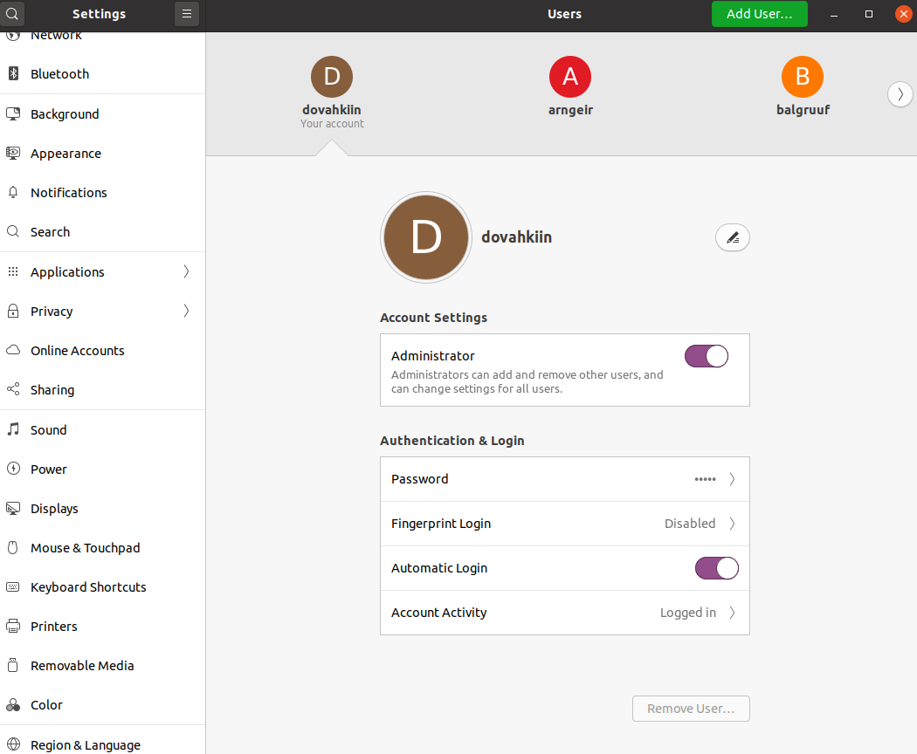
User Settings
Add specified users
Delete unauthorized users
Change insecure passwords
Remove/Give Administrator Privileges

Slide 6
User Settings Through Terminal
Add specified users
sudo adduser <username>
Delete unauthorized users
sudo deluser <username>
Change insecure passwords
sudo passwd <username>
Remove/Give Administrator Privileges
Remove: sudo deluser <username> sudo
Give: sudo adduser <username> sudo

Slide 7
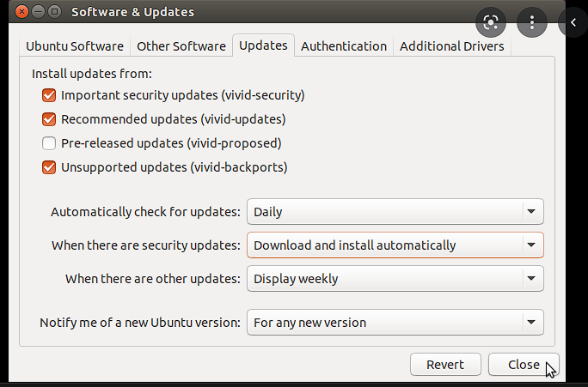
System Updates
/etc/apt/sources.list
Install updates from: ALL
Automatically check for updates: Daily
Updating
sudo apt-get update
sudo apt-get upgrade

Slide 8
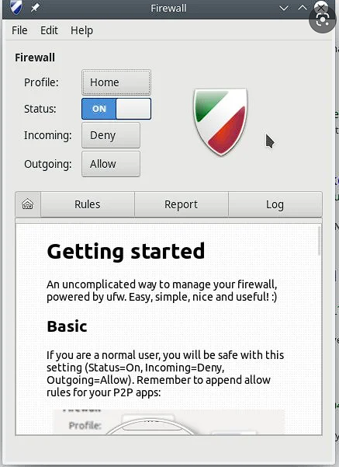
Firewall
gufw (User-friendly)
sudo apt-get install gufw
Defaults:
Deny incoming
Allow outgoing
Terminal
sudo ufw status
sudo ufw enable
sudo ufw default deny incoming
sudo ufw default allow outgoing

Slide 9
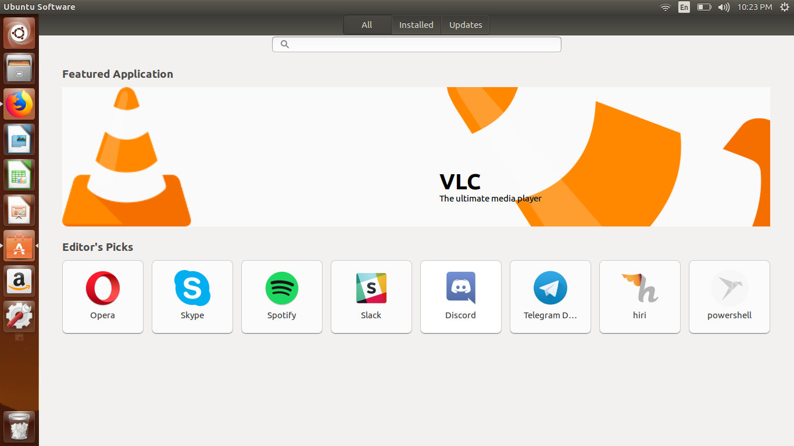
Finding Suspicious Files
Ubuntu Software Center
Under Installed
List all packages installed
dpkg -l
Try and find package by name
dpkg -S <name>
Prohibited files (ex. mp3 files)
sudo find / -name *.mp3
sudo rm <path to file>
ex. sudo rm /etc/music.mp3

